Slide 1
Reinforcement Project
Housing Dataset
Vignesh.vs
13-10-2025

Slide 2
Introduction
This dataset contains 4,600 rows and 18 columns related to housing details, including features like price, bedrooms, bathrooms, Date,sqft_living,sqft_lot, floors , waterfront, view, condition , sqft_above , sqft_basement, yr_built , yr_renovated , street, city , statezip, country.
Objective
The main objective of this dataset is to Analyze Housing Features and their impact on property prices
Goal
Exact understanding what factors affect house prices

Slide 3
Method of analysis: Exploratory Data Analysis (EDA)
Six major parts of this project:
1. Data Understanding
2. Data Cleaning/Preprocessing
3. Data Analysis (EDA Performed)
4. Feature Engineering
5. Visualizations
6. Insights and Recommendations

Slide 4
1. Data Understanding
import pandas as pd # pandas
import numpy as np # NumPy
import matplotlib.pyplot as plt # Matplotlib’s pyplot module
import seaborn as sns # Seaborn
import warnings
warnings.filterwarnings('ignore')
Data Loading
Housing = pd.read_csv('housing.csv', low_memory=False)
Steps
Housing.head()
Housing.info()
Housing.describe(include='all')

Slide 5
print(Housing.shape)
print(Housing.columns)
Cleanup (Large Number of missing values)
Housing.isnull().sum()
Housing.isnull().sum().sum()
Percentage of missing values in each column
round((Housing.isnull().sum() / len(Housing.index) * 100), 2).sort_values (ascending=False)
Identifying Rows with Maximum Missing Values
max_missing = Housing.isnull().sum(axis=1).max()
missing_rows = Housing[Housing.isnull().sum(axis=1) == max_missing]
print(missing_rows)

Slide 6

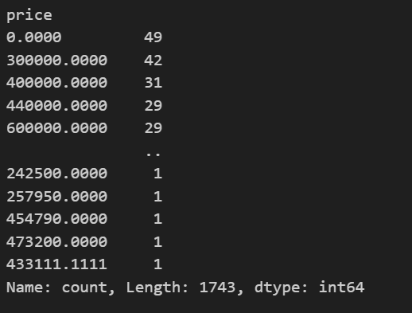
2) DATA CLEANING AND PREPROCESSING
Checking for Duplicates
Removing Fully Empty Rows
Housing.duplicated().sum() # Number of duplicate rows
Housing[Housing.duplicated()] # Display duplicate rows
Housing.dropna(how='all', inplace=True)
Checking Price Column Distribution
Housing['price'].value_counts()

Slide 7
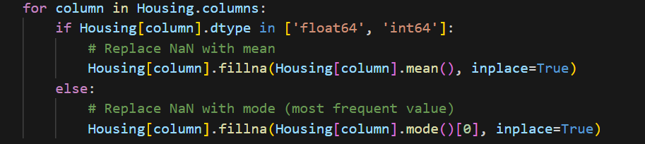
Handling Zero Prices
mean_price = Housing['price'].mean()
Housing['price'] = Housing['price'].replace(0, mean_price)
# Replace 0 values with mean price
Fill missing values based on column type

Slide 8
3) Data Analysis (EDA Performed)
What is Exploratory Data Analysis (EDA)?
EDA is the process of exploring and summarizing datasets to understand their structure, patterns, and key features.
1. Univariate Analysis
Focuses on a single variable to understand its distribution,
2. Bivariate Analysis
Studies the relationship between two variables to detect connections,
3. Multivariate Analysis
Explores three or more variables simultaneously to understand complex relationships,

Slide 9
1. Univariate Analysis
Distribution of price, floors, bedrooms.
I used hist plot and count plot for this.
2. Bivariate Analysis
Scatter plot of price vs city.
3. Multivariate Analysis
Correlation heatmap of numeric features.
Pair plot of first 5 numeric features.

Slide 10
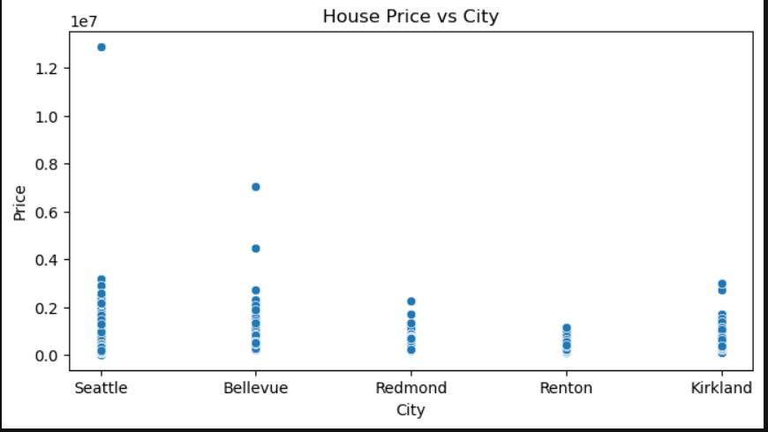
VISUALIZATION OF BED ROOMS:
Seattle has the highest house prices, with some reaching up to 1.2 million, indicating it’s the most expensive city in the dataset.
Bellevue follows with prices peaking around 0.8 million, suggesting it’s a high-value market but below Seattle.
Renton and Kirkland show lower price ranges, mostly below 0.4 million, with fewer outliers, indicating more affordable housing options.
Redmond has a moderate price distribution, with most houses around 0.4-0.6 million, showing a balanced market compared to the extremes.

Slide 11
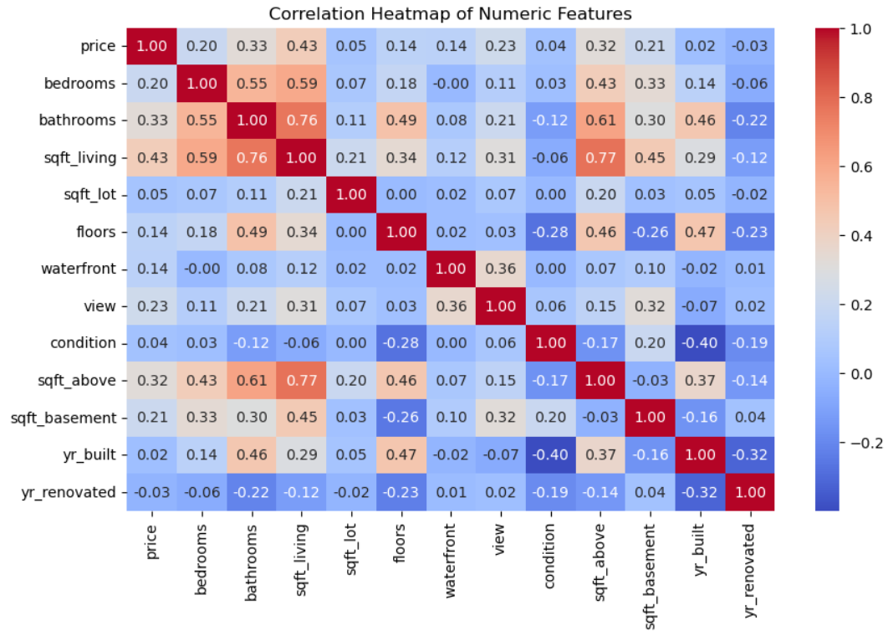
VISUALIZATION OF HEATMAP:
Sqft_living (0.43) and sqft_above (0.32) are the strongest positive correlates with price, highlighting the importance of living space size.
Waterfront (0.36) and view (0.15) positively influence price, suggesting location perks add value.

Slide 12
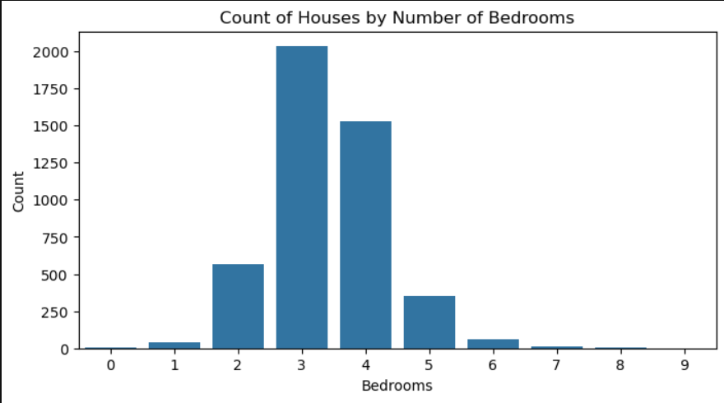
VISUALIZATION OF BED ROOMS:
The majority of houses have 3 bedrooms, with a count exceeding 2000, indicating it’s the most common configuration.
Houses with 4 bedrooms follow closely, with a count around 1500-1750, suggesting a strong demand for this size as well.
Houses with 2 bedrooms have a significant count (around 500-750), showing a notable presence of smaller homes
Houses with 0, 1, or 5-9 bedrooms are much less common, with counts dropping sharply, indicating these are less preferred or rare options.

Slide 13
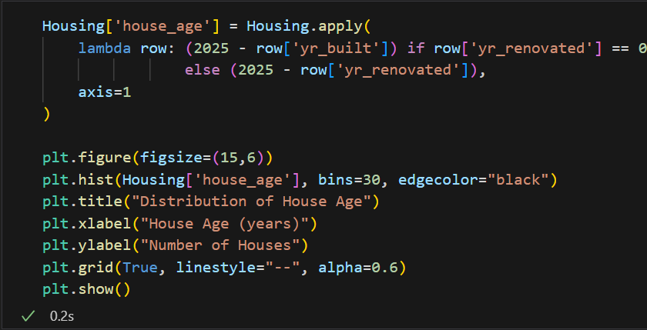
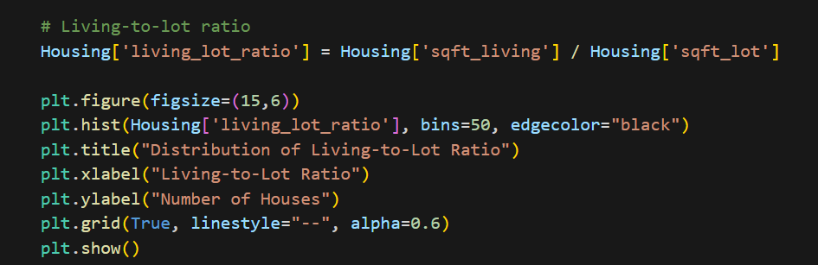
4. Feature Engineering
Feature engineering for EDA
Create house_age from yr_build and yr_renovated
Create Living_lot_ratio (sqft_living) / (sqft_lot)

Slide 14
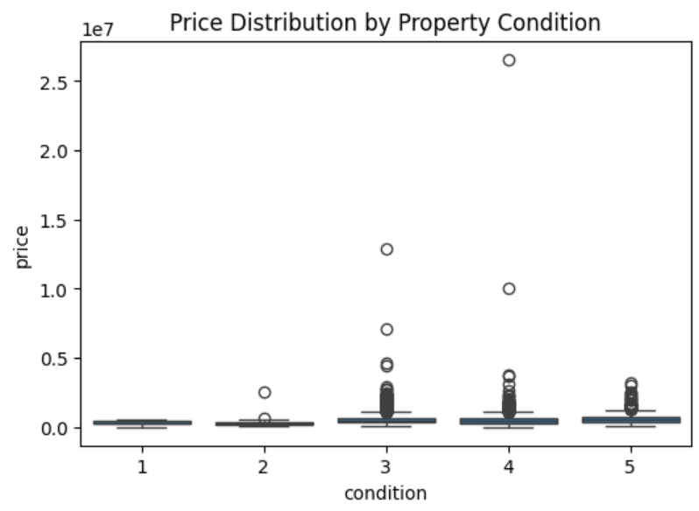
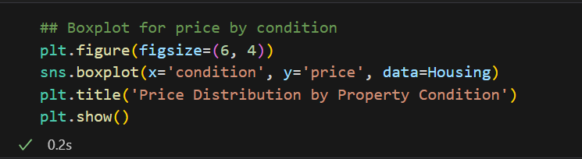
5) Visualizations

Slide 15
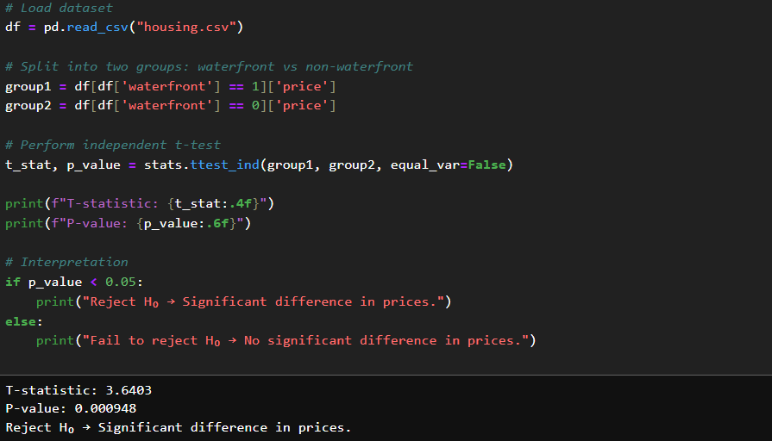
HYPOTHESIS TESTING

Slide 16
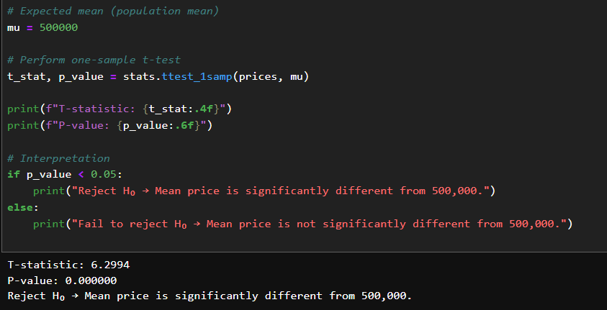
ONE SAMPLE T-TEST

Slide 17
Key Insights
Overall Market
Average house price: ~$560K
Median house price: ~$469K
House Characteristics
Most common configuration: 3 bedrooms, 2.5 bathrooms
Average size: 2,139 sqft living area
Recommendations
For Buyers
Buying in developing cities may provide better value.
For Sellers / Investors
Focus on living area and bathroom count in listings.
Waterfront and scenic view homes can be priced higher.

Slide 18


